Slide 1


STUDENT DETAILS
NAME : GARIMA SHARMA
SKILLSBUILD EMAIL ID : 502garima@gmail.com
STUDENT ID AICTE : STU61644435acd731633961013
COLLEGE NAME : DAYALBAGH EDUCATIONAL INSTITUTE
COLLEGE STATE : UTTAR PRADESH
INTERNSHIP DOMAIN AND INTERNSHIP START AND END DATE : ARTIFICIAL INTELLIGENCE / 12.06.2023 – 24.07.2023

Slide 2
PROJECT TITLE/PROBLEM STATEMENT
PROJECT TITLE : AI MENTAL FITNESS TRACKER
PROBLEM STATEMENT : Mental health is a crucial aspect of overall well-being, and with the increasing prevalence of mental health disorders globally, it has become essential to develop effective tools for monitoring and improving mental fitness. Existing self-assessment methods often rely on subjective reporting, which can be prone to biases and inaccuracies. Therefore, there is a need for a reliable and objective system that can track and evaluate an individual's mental health status using advanced technologies like Artificial Intelligence (AI).

Slide 3
AGENDA
MENTAL FITNESS TRACKER USING REGRESSION

Slide 4
PROJECT OVERVIEW
The project overview above provides a brief summary of the AI Mental Fitness Tracker using regression, outlining its objectives, methodology, expected outcomes, and potential impact. The actual implementation of the project may vary depending on available resources, data availability, and specific requirements.

Slide 5
WHO ARE THE END USERS OF THIS PROJECT?
Regression-based AI Mental Fitness Tracker's end customers may include those who want to keep track of and advance their mental fitness. By offering precise assessments, individualized recommendations, and ongoing monitoring, the project seeks to empower people to actively manage their mental health.

Slide 6
YOUR SOLUTION AND ITS VALUE PROPOSITION
Solution
The solution is an AI-powered Mental Fitness Tracker that utilizes regression analysis to accurately assess and monitor an individual's mental fitness. By analyzing various factors such as mood, stress levels, sleep patterns, physical activity, and social interactions, our tracker provides a comprehensive and data-driven evaluation of mental well-being.
Value Proposition
Empowering Individuals: Our solution empowers individuals to take an active role in managing their mental health. By providing accurate assessments, continuous monitoring, and personalized recommendations, it enables users to make informed decisions and proactively improve their mental well-being. Early Intervention and Prevention: The AI Mental Fitness Tracker facilitates early intervention by detecting potential signs of mental health decline. By identifying patterns and changes in mental fitness levels, individuals can take proactive measures to prevent the onset or escalation of mental health issues.

Slide 7
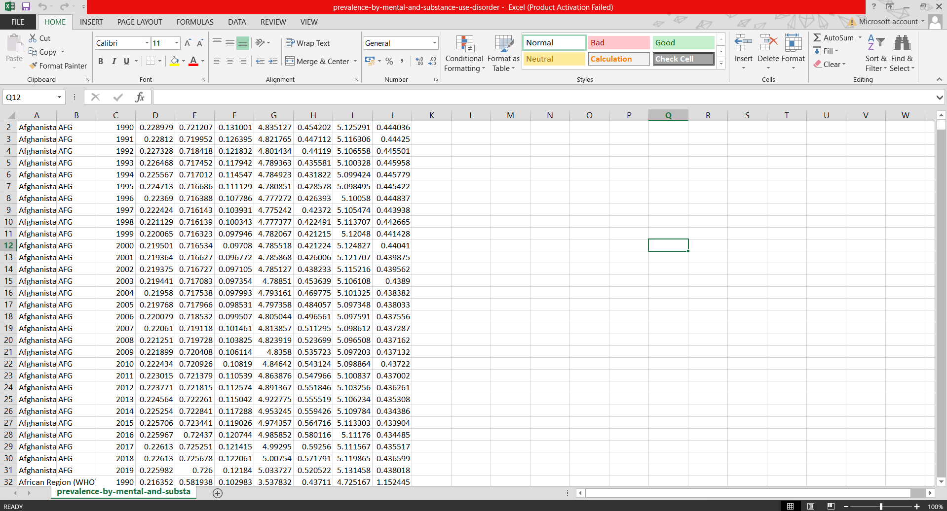
DATASET OF MENTAL FITNESS TRACKER ANALYSIS AND PREDICTION FIRST DATASET
https://drive.google.com/file/d/1B14pHI1jpVKSkaB0qJ59Bs55c2QjZYA2/view?usp=drive_link

Slide 8
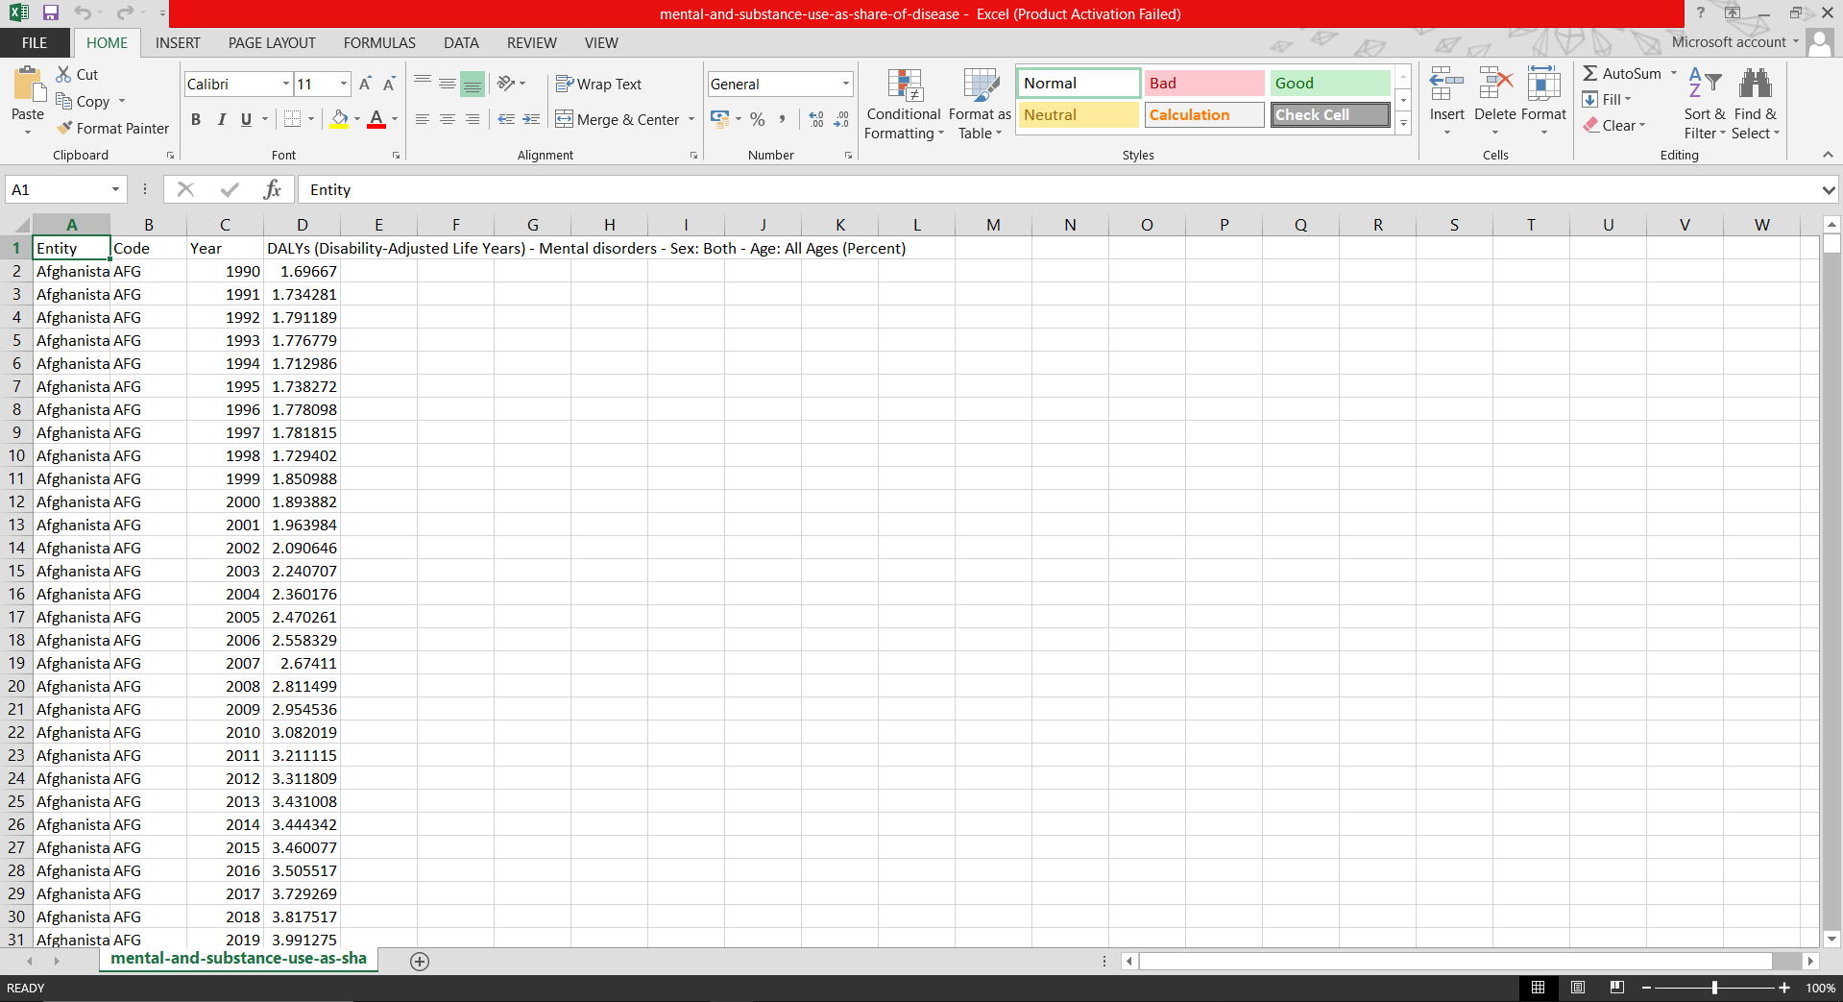
SECOND DATASET
https://drive.google.com/file/d/1BHotRwLT2xVQEHTdiDY3Sj6P_3g7489L/view?usp=drive_link

Slide 9
HOW DID YOU CUSTOMIZE THE PROJECT AND MAKE IT YOUR OWN
Perform Exploratory Data Analysis and after that perform Random Forest and Linear Regression to make model more efficient.

Slide 10
MODELLING
Gather pertinent information about indicators of mental health, such as mood, stress levels, sleep habits, activity levels, and social interactions. Self-reporting, wearable technology, questionnaires, or other sources are all possible ways to get this information.
Data preprocessing: To assure the acquired data quality and consistency, clean and preprocess it. Deal with missing values, outliers, and any other data quality problems that can impair the models' accuracy.
Identifying and extracting significant features that are a good indicator of a person's degree of mental fitness from the obtained data is known as feature engineering. In this step, pertinent variables are chosen, variables may need to be transformed, and new features that capture crucial elements of mental health are created.
Depending on the nature of the data and the issue at hand, select the best regression models. Regression models that are often used include those that use linear, polynomial, multivariate, or more complex methods like ridge or support vector regression.

Slide 11
CONTD…
Split the preprocessed data into training and validation sets before starting to train the models. The chosen regression models should be trained by fitting the data to them using the training set. Throughout this process, the models pick up on the connections between the input features and the goal variable (mental fitness level).
Model Evaluation: Use appropriate evaluation measures, such as mean squared error (MSE), R-squared value, or root mean squared error (RMSE), to gauge the effectiveness of the trained regression models. Analyze the models' accuracy in predicting a person's degree of mental fitness using the provided features.
Model refinement: To enhance the performance of the models, fine-tune them by modifying their hyper parameters or investigating various regression procedures. In this iterative process, many model configurations are tested, and the model with the greatest performance is chosen based on the assessment metrics.
Deploy the models in a system that enables ongoing monitoring of mental health indicators once they have been trained and validated. The models should be able to quickly analyze fresh data, spot patterns, and offer up-to-date evaluations of a person's level of mental fitness.

Slide 12
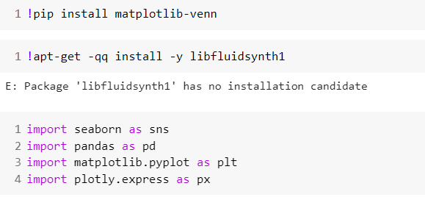
CODE
Step 1 :- Import Required Libraries

Slide 13
Step 2 :- Load and Prepare the Data

Slide 14
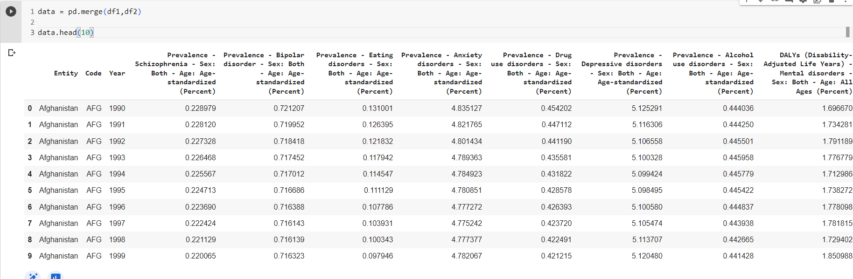
Step 3 :- Merging both the Dataset

Slide 15
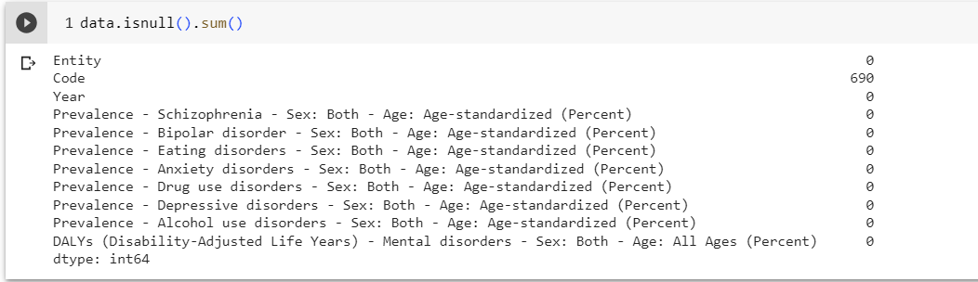
Step 4 :- Data Cleaning

Slide 16
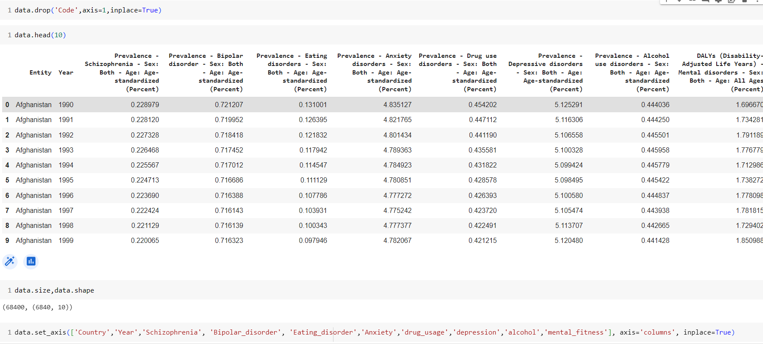
Step 4 :- Data Cleaning

Slide 17

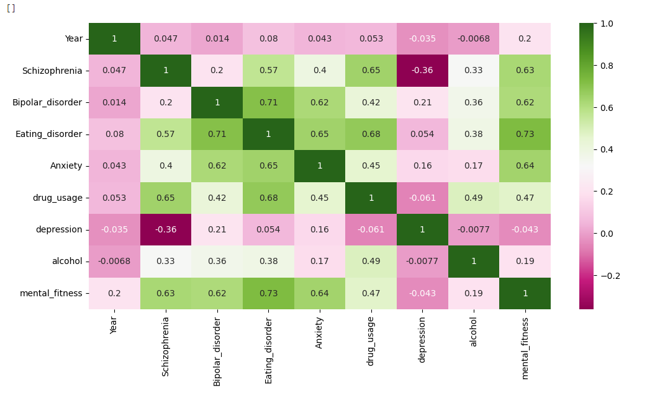
Step 5 :- Exploratory Analysis
1. Heap Map

Slide 18
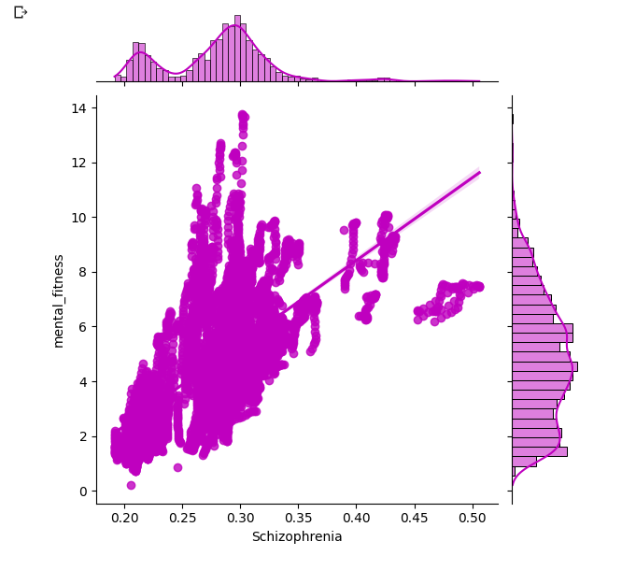
2. Joint Plot

Slide 19
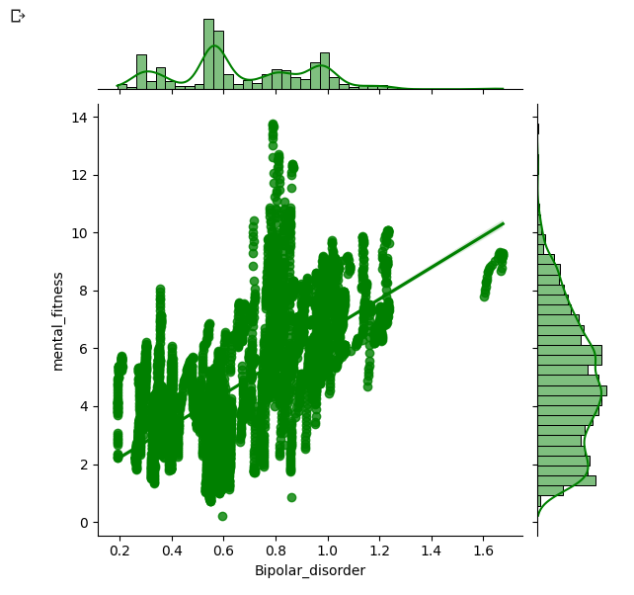
3. Joint Plot

Slide 20

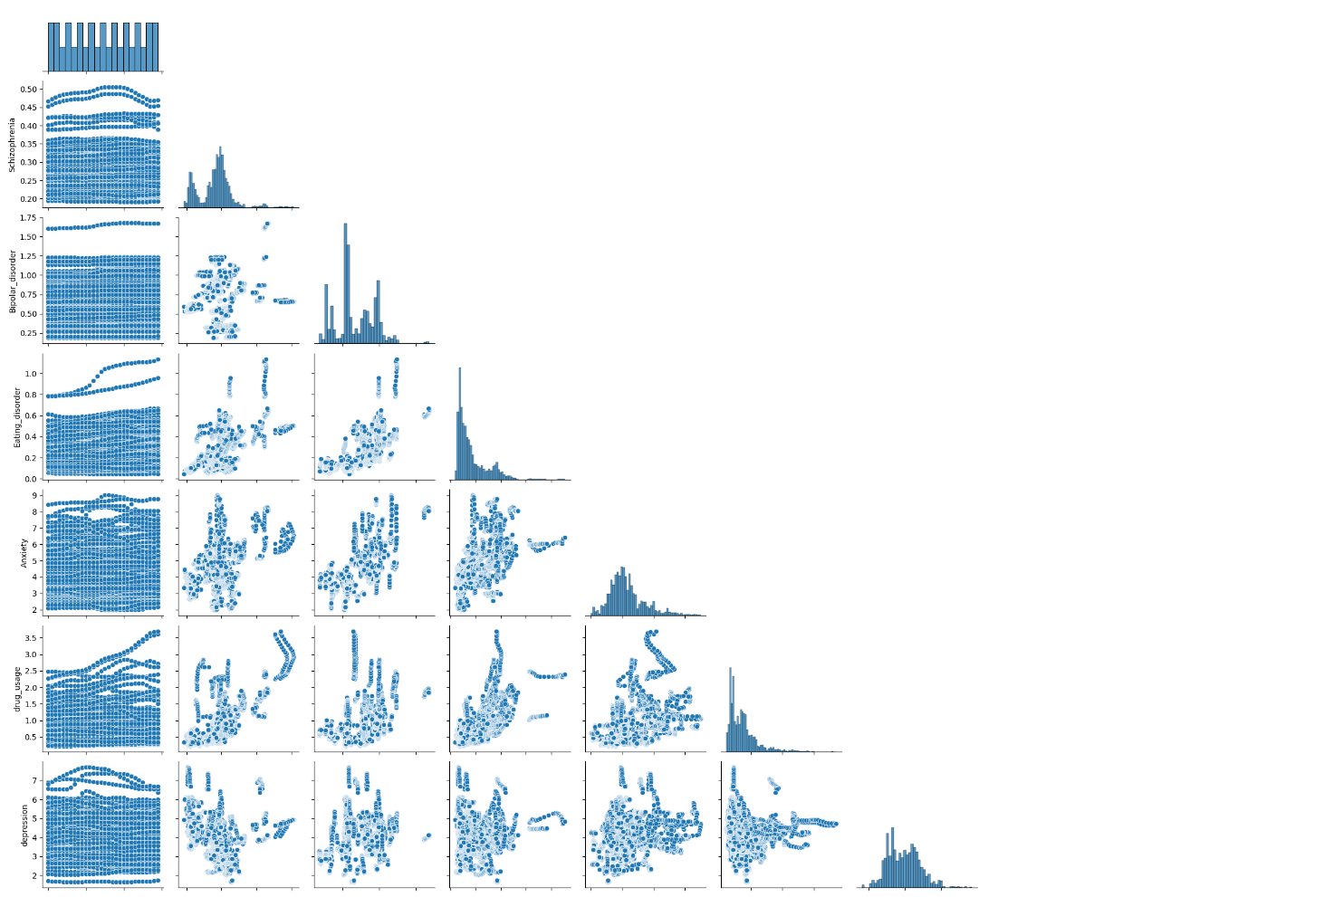
3. Pair Plot

Slide 21
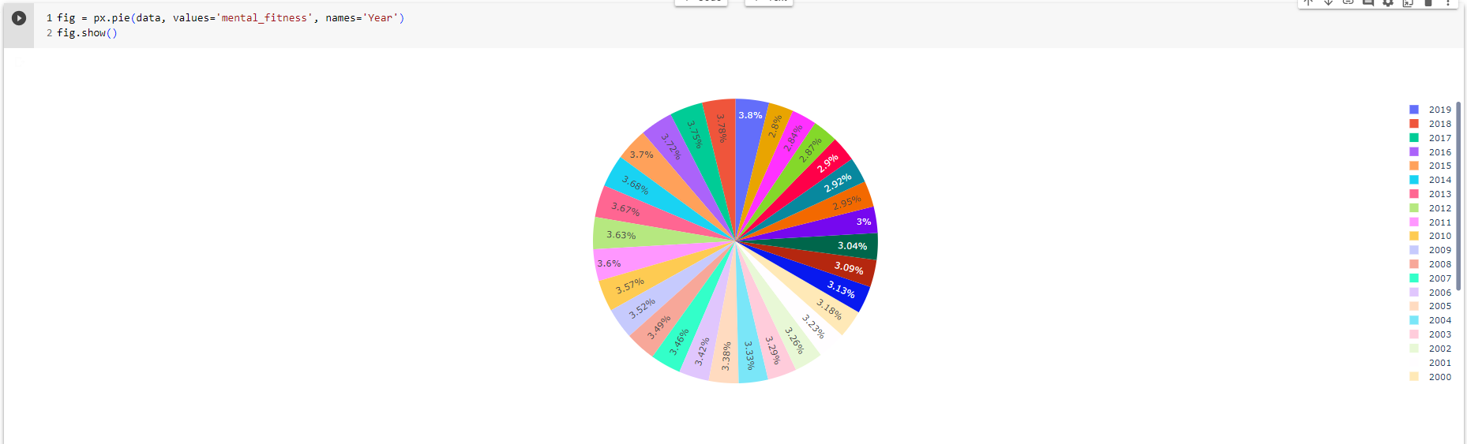
3. Pie Plot

Slide 22
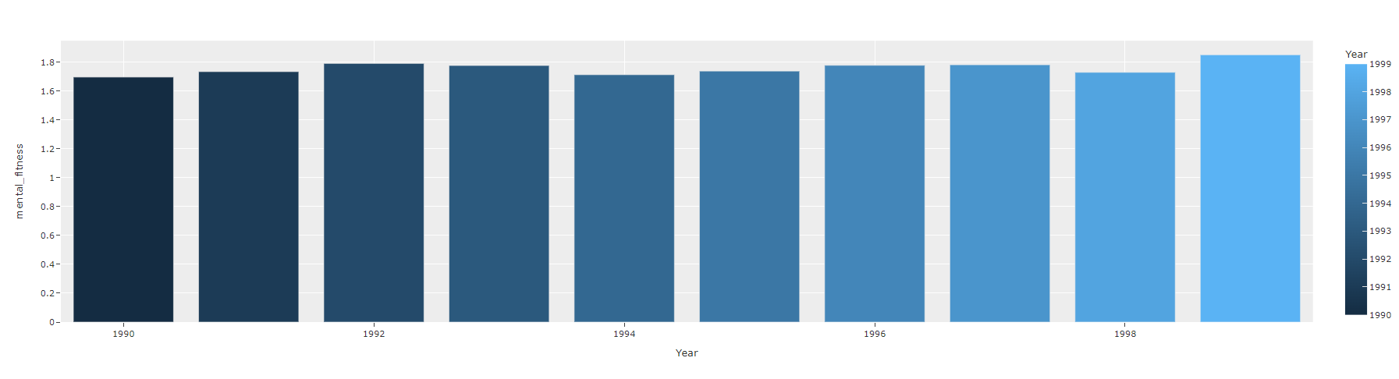
3. Bar Plot

Slide 23
3. Bar Plot

Slide 24
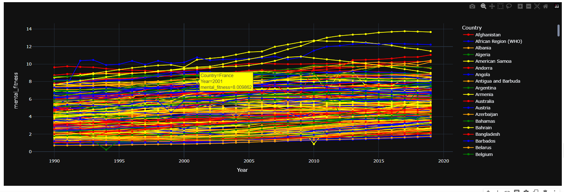
Step 6 :- Year wise Variation in Mental Fitness of Different Countries

Slide 25
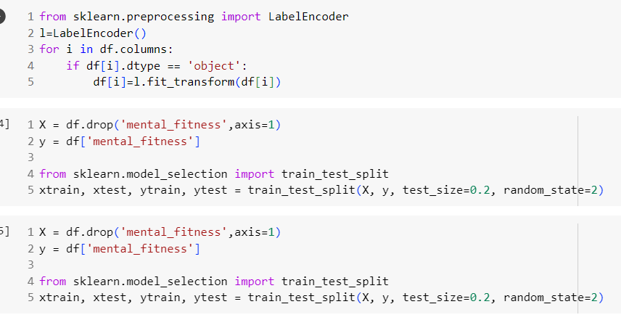
Step 7 :- Pre-processing

Slide 26
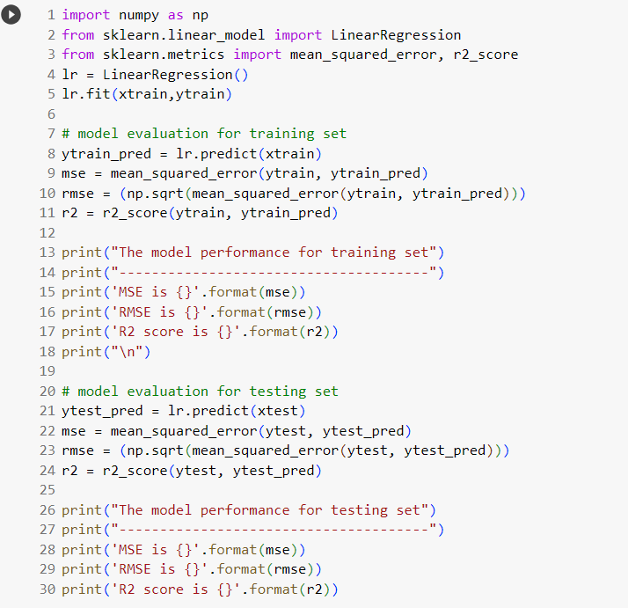
Step 8 :- Perform Linear Regression

Slide 27
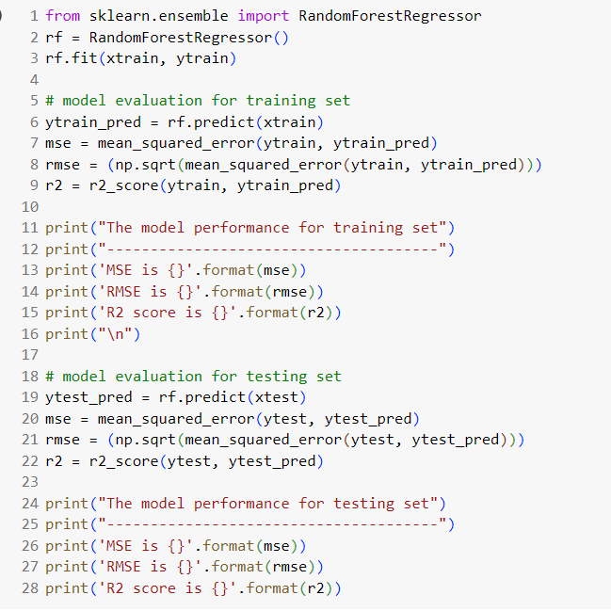
Step 9 :- Perform Random Forest

Slide 28
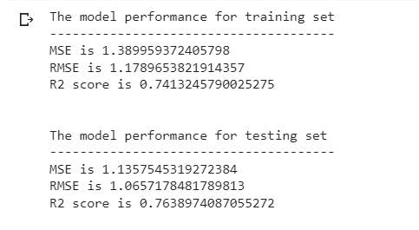
RESULTS
Linear Regression

Slide 29
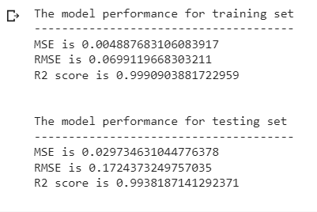
RESULTS
Random Forest

Slide 30
LINKS
Google Colab -- https://colab.research.google.com/drive/1dgvYCir5r2xDwM0ZOhVGR4taDWDZz8QT?usp=sharing
Drive -- https://drive.google.com/drive/folders/1lZlUGdS-gPfyxAs7SANVaFZQjAMLD4Kj?usp=sharing

